Slide 1
MIA Lab
Final Presentation:
Hypothesis 6
Group 6: Abdelrahman Faqieh, Alexander Aeschbacher, Zejun Yan

Slide 2
Feature extraction and selection
Hypothesis: The segmentation becomes more accurate with a large amount of features.
What types of features are useful? Radiomics and/or Deep-Learning features?
All or sub-set of features improve segmentation performance?

Slide 3
Outline
Motivation
Adapted MIA Pipeline
Data Processing Workflow
Feature extraction and selection
Experiments and Results
Conclusion
Outlook

Slide 4
Motivation
There is an unmet clinical need: performing the segmentation task manually is time-consuming, user-dependent, and costly
The solution is the medical image segmentation task through an automated machine learning (ML) approach. The pipeline aims to classify each voxel of a brain MR image in one of these classes (Background, Cortical and cerebellar white matter, Cerebral and cerebellar grey matter, Hippocampus, Amygdala and Thalamus)
A typical optimization for faster processing is to check if we can reduce the number of features to decrease the model complexity and the computational burden.

Slide 5
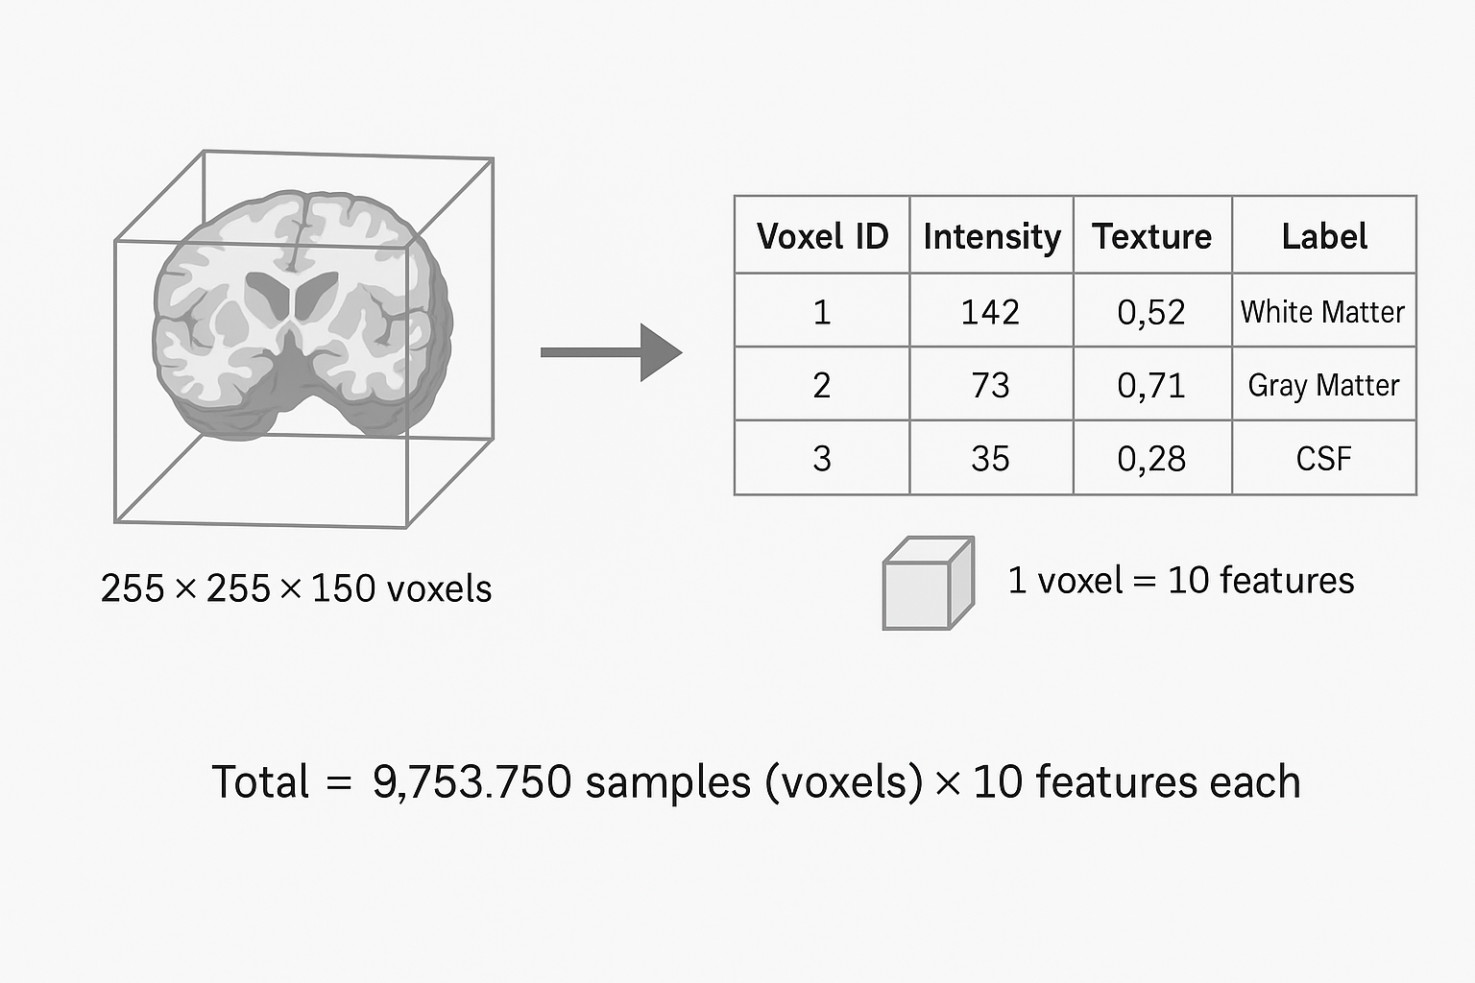
Segmentation in Images

Slide 6
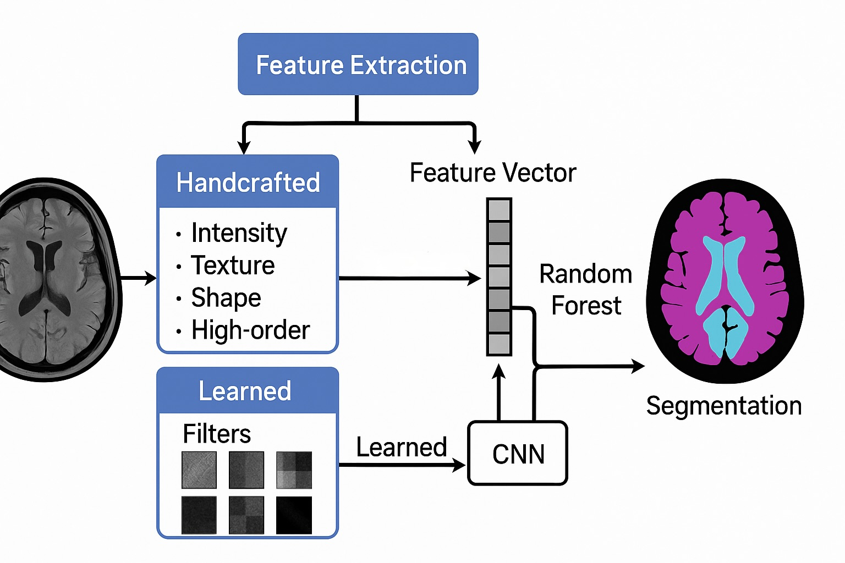
Features in DL vs ML

Slide 7
Adapted MIA Pipeline
First order
Shape
Feature
Extract
(Radiomics)
Registration
Pre-processing
Random Forest Classification
Texture
High-order
Evaluation
Segmentation
Post-processing
Notes:
Input data:
T1native (the primary anatomical reference image, serves as the base image for registration, segmentation and normalization)
T2native (complementary contrast image, improves accuracy when combined with T1)
Labels_native (ground truth segmentation in the subject’s native space)
Brainmasknative (skull-stripping mask)
Affine (affine transformation matrix)
The pipeline:
Input (T1native and T2native provide complementary contrast) → Registration (with affine file, the affine transformation aligns both T1 and T2 to a reference) → Pre-processing (skull stripping with Brainmasknative file, intensity normalization, bias correction) → Feature extraction (radiomic and deep learning features)
→ Classification (using extracted features to classify voxels into 6 different regions) → Post-processing (with labels_native file, remove small artifacts, enforce spatial consistency) → final segmentation labels →Evaluation (Compare the final segmentation to GT) with metrics (Dice coefficient, Hausdorff distance)

Slide 8
Data processing workflow
Subject 1
Features Subject 1
Train
set
Subject 2
Features Subject 2
MIA
Pipeline
(registration->
pre-processing->
feature extraction)
Subject 3
Features Subject 3
Split
by subject
Test
set
Subject 29
Features Subject 29
Subject 30
Features Subject 30

Slide 9
Data processing workflow
Train
set
Test
set
Random Forest
classification
Post-processing
Segmentation
Evaluation

Slide 10
Methods – Feature extraction
Radiomics
First-order
(intensity-based)
E.g. distribution of voxel intensities
Shapes (2D/3D)
E.g. volume, compactness, sphericity)
Texture (spatial patterns and heterogeneity)
E.g. GLCM, GLRLM, GLSZM and NGTDM
High-order
E.g. wavelet and Laplacian of Gaussian

Slide 11
Methods – Feature selection
Decision forest feature importance (model-based)
Principal Component Analysis (projection-based)
Mutual Information based Feature Selection (information-theoretic)
Notes:
HOGs = Histogram of Oriented Gradients

Slide 12
Later on
Experiment and Results - Radiomic features
Experiment and Results - Selected radiomic features
Conclusion
Outlook

Slide 13

Thanks for listening!
Notes:
hsd dist
95 in add
maybe 90
seperated pip

Slide 14
References
Zhang, W., Guo, Y. and Jin, Q., 2021. Radiomics and Its Feature Selection: A Review. Symmetry, 13(3), p.435. https://doi.org/10.3390/sym13030435
Pereira, S., Pinto, A., Oliveira, J., Mendrik, A.M., Correia, J.H. and Silva, C.A., 2016. Automatic brain tissue segmentation in MR images using Random Forests and Conditional Random Fields. Journal of Neuroscience Methods, 270, pp.111–123. https://doi.org/10.1016/j.jneumeth.2016.06.017
Peng, H., Long, F. and Ding, C., 2005. Feature selection based on mutual information: Criteria of max-dependency, max-relevance, and min-redundancy. IEEE Transactions on Pattern Analysis and Machine Intelligence, 27(8), pp.1226–1238. https://doi.org/10.1109/TPAMI.2005.159
Hutter, J., Price, A.N. and Hajnal, J.V., 2017. Deep learning for brain MRI segmentation: State of the art and future directions. Journal of Magnetic Resonance Imaging, 47(2), pp.505–520. https://doi.org/10.1002/jmri.25734

